Slide 1

Major Project on AUTOMATIC HIGHLIGHT GENERATION USING PYTHON Presented by Kamesh Shekhar Prasad (Registration Number : 17352214) Under the Guidance of Mr. S. Balaji Master of Computer Applications Department of Computer Science Pondicherry University, Karaikal Campus

Slide 2
TABLE OF CONTENTS
Introduction
Objectives
Proposed System
Implemented methods
System Requirements
Code Snippet
Results & Evaluation
Conclusion & Future Scope

Slide 3
INTRODUCTION
Cricket Highlights are used to catch fleeting finishes to matches rather than the whole package.
I am using Simple speech analysis approach to generate highlight using python.

Slide 4
OBJECTIVES
The aim of this project is to automate the process of highlight extraction from a full match sports video using simple speech analysis.

Slide 5
ARCHITECTURE OF THE PROPOSED MODEL
Input(Full Match Video)
Extract Audio
Break Audio into Chunks
Merge all excitement clips.
Compute Every Chunk as Excitement or not
Compute Short time energy of every chunk

Slide 6
IMPLEMENTED METHODS
We used “librosa” package to get duration of audio clips.
We used “Matplotlib” package to Visualize the chunk in the time-series domain.
We used “numpy” package to compute the Short Time Energy for every chunk.

Slide 7
System Requirements
Windows 10
Python 3.0 or above
librosa Package
Matplotlib Package
numpy Package
Pandas Package
moviepy Package

Slide 8
CODE SNIPPET

Slide 9
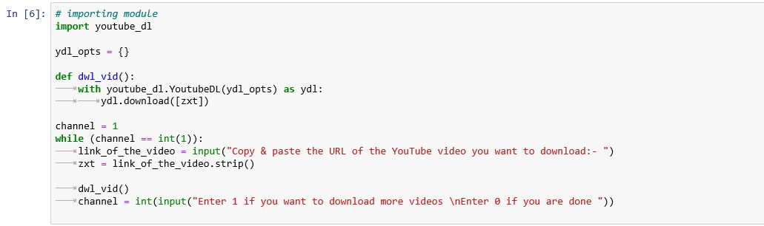
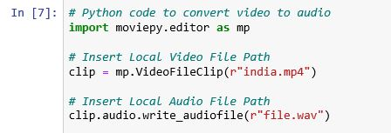

Slide 10
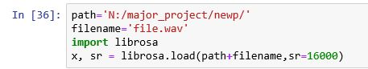
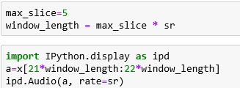

Slide 11
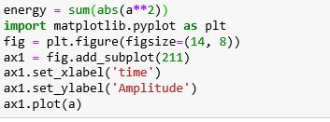

Slide 12
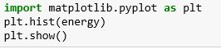
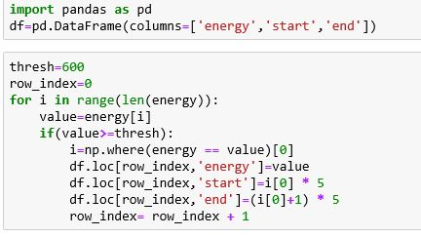

Slide 13
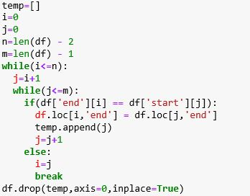
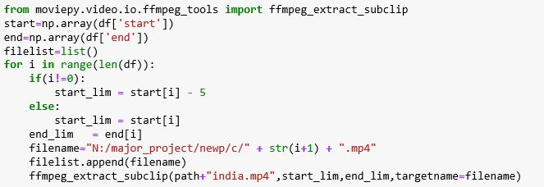

Slide 14
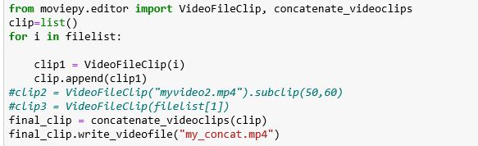

Slide 15
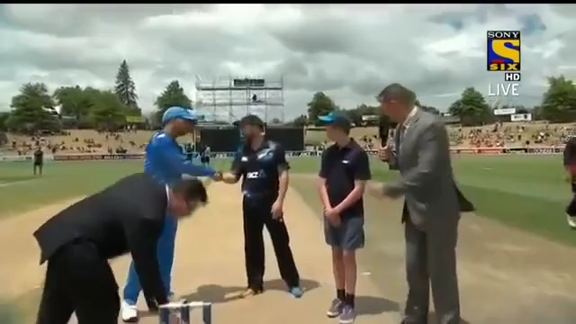
RESULTS
81%
80%
78%
76%

Slide 16
CONCLUSION & FUTURE SCOPE
We conclude that using librosa package it is easier to automatically generate highlights using python.
In future, the work can be extended to use this approach to generate highlight of other sports also.

Slide 17
REFERENCES
Become a video Analysis Expert: A Simple Approach to Automatically Generating Highlihgts using Python – Aravind Pal.
Librosa package official documentaion https://librosa.github.io/librosa/

Slide 18
THANK YOU

